Slide 1
Introduction to Intelligent Experiences
Geoff Hulten

Slide 2

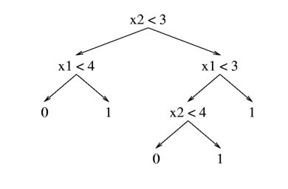




What is an Intelligent Experience
Hello User!
P(LikeSong): 32.612%
Drive the UX
P(LikeSong)
Raw Prediction
Modes of Intelligent Interaction:
Playing a Song…
Should I Play a Song?
Choose a Song…
Choose a Song…
Yes
No
Automate
Prompt
Organize
Annotate
Which to use?

Slide 3
Goals of Intelligent Experiences
Achieve Objectives
Mitigate Mistakes
Get Data to Improve
Change behaviors
Positive outcomes
Drive engagement
Cost of mistakes
Ease to identify
Ease of recovery
Closed Loop
Honest outcome
Unbiased

Slide 4
Example: Home Light Automation
Objective: Full Automation
Objective: Save Power
Objective: Keep Users Safe
Automate: on with moderate threshold
Automate: off with conservative threshold
Mistakes:
User in the dark, waving arms
Light flickering on and off
Never turn on
Automate: off with conservative threshold
Prompt: turn off with aggressive threshold
Annotate: power warning
Mistakes:
User never turns off, system leaves on
Lots of prompts, user disconnects
Training Data?
Automate: on with aggressive threshold
Turn off after long period of repeatedly passing conservative threshold
Mistakes:
Light is always on
Someone gets hurt…

Slide 5
Why Intelligent Experiences are hard pt 1: There will be Many Mistakes
Mistakes
Experience with Mistakes
97% Accuracy – very, very good
100,000 users with 3 interactions per day:
9,000 mistakes per day
63,000 mistakes per week
3.2 million mistakes per year
Each user expects:
1 mistake per ~11 days
~30-35 mistakes per year
At what point do the mistakes ruin the utility?
Consider each experience two ways:
What to do if the user got there because the model was right
What to do if the user got there because the model was wrong

Slide 6
Why Intelligent Experiences are hard pt 2: The Mistakes Will Change
Intelligence Changes
Problem Changes
You have a better model +2%!
More things got better than worse
But some things got worse…
New mistakes
Randomly distributed?
Focused on certain users?
Cheap or costly?
Which part of the curve?
New contexts appear
Model tends to be worse at new things…
Latency in catching up?
Old contexts disappear
Things users liked yesterday gone today
Meaning of a context change
Enough users perceive it differently
But not all users…
Change can feel like a mistake – even when it is for the good…

Slide 7

Why Intelligent Experiences are hard pt 3: The Uncanny Valley
Human Factors
Familiarity
Tool or Relationship?
‘Same Input’ different output
ML mistakes not like human mistakes
Humans get fatigued
Intelligence can be creepy…
0%
Human Likeness
100%

Slide 8
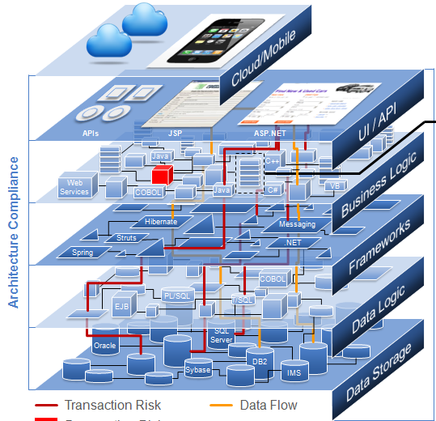
Balancing Intelligent Experiences
Machine
Learning
Notes:
Note Sketch: Tell the story about how many times in my career some earnest PM has come to me and shown me a huge, complex, convoluted architecture. I ask ‘why are you showing me this’. They then point out the red box, where ‘machine learning’ will go. In their mind I’m going to do something in that red box that is going to magically make the rest of this gibberish work…
But that’s not how it works. To get impact from machine learning you need to integrate it throughout the system and get it into balance. The rest of this talk is going to be about what it means to do that.

Slide 9
Balancing an Intelligent Experience
Forcefulness
Frequency
Value of Success
Cost of Failure
Quality of the Intelligence
If the intelligence is poor…
E.g. when the system is new
If the cost of a mistake is high…
E.g. a surgical robot
If there is legacy UX…
E.g. integrating into an existing application

Slide 10
Forcefulness
An experience is forceful if:
It is hard for the user to miss
It is hard for the user to ignore
It is hard for the user to stop
An experience is passive if:
It is easy for users to miss
It is easy for the user to ignore
It takes explicit work to accept
Forceful experience useful when
Model quality is high
Value of success >> cost of failure
Training data is valuable
Passive experience useful when
The interaction is frequent
Value of success << what user is doing
Cost of mistake is high

Slide 11
A Balancing Example: Spam Filtering
Delete
Suppress
Inform
Hybrid Experience
Notes:
Let's go through an example of balancing the quality of the intelligence and the forcefulness of the experience.
The quality of the intelligence refers to how many mistakes it makes -- and I promise you your intelligence makes mistakes, just about everything built with machine learning is going to make mistakes.
The forcefulness of the experience refers to how bold it is when taking actions -- does it do small things or big things? Are they easy to undo or hard to undo when there is a problem?
So let’s consider a system to combat spam email. When an email arrives, the intelligence examines it and predicts if the message is a spam or not.
A forceful experience would be to delete every message that the intelligence thinks is spam. The intelligence thinks an email is spam? Poof. Gone.
If the intelligence is super accurate that's great because users never need to think about spam, they never see it, they never waste any time dealing with it. But when the intelligence makes a mistake -- that's a pretty costly mistake. The user's important communications are deleted with no notification and no recourse.
<SLIDE>
A less forceful experience would be to move the emails that the intelligence thinks are spam to a junk folder. This isn't as nice, because users have to read through their junk folders every so often. But it is a tradeoff that allows a less accurate intelligence to provide significant value to users.
<SLIDE>
Less forceful still would be to put every email message into the user's inbox, but to annotate the ones that the intelligence thinks are spam with some hints to the user. Maybe by adding a note to the top of suspicious emails that says 'reminder, don't give out personal information in response to emails’.
So which is right?
It depends on the rest of the system. If the intelligence is perfect, then the most forceful experience is best. But if not you might need to balance the rest of the system to adapt, and one way is by having a less forceful or less frequent experience.
Most systems will have some form of hybrid experience, which behaves differently on easy parts of the problem that it does on harder parts of the problem.

Slide 12
Frequency of Interaction
How often is the model called, and how do the predictions get used
Frequent interactions tend to fatigue users (especially forceful ones)
Get desensitized and start ignoring the intelligent experience
Get irritated and turn off the intelligent feature
Infrequent interactions have fewer opportunities to create value

Slide 13
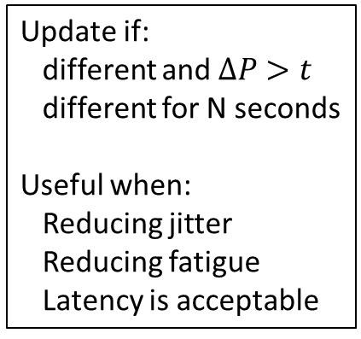
Approaches to Frequency
Now Playing…
Now Playing…
Now Playing…
Now Playing…
>>
Whenever Prediction Changes
For Significant Changes
Interaction Budget
User Initiated
Every second:
Call Model
Update UX
Useful when:
Realtime control
Extreme change
High-quality model
Update if:
different and $∆P>t$
different for N seconds
Useful when:
Reducing jitter
Reducing fatigue
Latency is acceptable
No more than:
N per session
N pre minute
Useful when:
Testing interactions
Reducing fatigue
Gathering Data
No more than:
N per session
N pre minute
Useful when:
Users will actually do it
Backstop for others
Model User & Interact as often as they will respond favorably

Slide 14
Value of Success
Interaction Valuable to User if…
Interaction Valuable to You if…
Noticed that it happened
Cares that it happened
Connects outcome to intelligence
Feels it was in their interest
Thinks the system is cool
Increases engagement
Improves sentiment
Causes user to give you money
Creates good training data

Slide 15
Cost of Failure
Knowing there is a Mistake
The Cost of Mistakes
Mitigating the Mistake
User can recover from the damage if they do notice
Double checking intelligent system’s work
Reduced value of success
Loss of trust
Fatigue
User can’t blame the intelligent system if they don’t notice…
Users don’t really care
Users waste a few seconds
Costs the user money
Costs you money
Hurts Engagement / Sentiment
Undo experience
Manual undo
Support escalation
Other options
Delay the action
Avoid bad mistakes altogether
Limit Interactions

Slide 16
Summary
Goals of Intelligent Experience
Balancing Intelligent Experiences
Present predictions to the user
Achieve the users’ & system’s objectives
Minimize intelligence flaws
Create data to grow the system
Hard Because of:
Mistakes
Change
Human Factors
Forcefulness
Frequency
Value of Success
Cost of Failure
Quality of the Intelligence
Change can feel like a mistake – even when it is for the good…

